Slide 1
Hadoop Programming

Slide 2
Overview
MapReduce Types
Input Formats
Output Formats
Serialization
Job
http://hadoop.apache.org/docs/r2.2.0/api/org/apache/hadoop/mapreduce/package-summary.html

Slide 3
Mapper<KEYIN,VALUEIN,KEYOUT,VALUEOUT>
Maps input key/value pairs to a set of intermediate key/value pairs.
Maps are the individual tasks which transform input records into a intermediate records. The transformed intermediate records need not be of the same type as the input records. A given input pair may map to zero or many output pairs.
The Hadoop Map-Reduce framework spawns one map task for each InputSplit generated by the InputFormat for the job.
The framework first calls setup(org.apache.hadoop.mapreduce.Mapper.Context), followed by map(Object, Object, Context) for each key/value pair in the InputSplit. Finally cleanup(Context) is called.
http://hadoop.apache.org/docs/r2.2.0/api/org/apache/hadoop/mapreduce/Mapper.html

Slide 4
public static class TokenizerMapper
extends Mapper<Object, Text, Text, IntWritable>{
private final static IntWritable one = new IntWritable(1);
private Text word = new Text();
public void map(Object key, Text value, Context context
) throws IOException, InterruptedException {
StringTokenizer itr = new StringTokenizer(value.toString());
while (itr.hasMoreTokens()) {
word.set(itr.nextToken());
context.write(word, one);
}
}
}

Slide 5
What is Writable?
Hadoop defines its own “box” classes for strings (Text), integers (IntWritable), etc.
All values are instances of Writable
All keys are instances of WritableComparable

Slide 6
Writable
A serializable object which implements a simple, efficient, serialization protocol, based on DataInput and DataOutput.
Any key or value type in the Hadoop Map-Reduce framework implements this interface.
Implementations typically implement a static read(DataInput) method which constructs a new instance, calls readFields(DataInput) and returns the instance.
http://hadoop.apache.org/docs/r2.2.0/api/org/apache/hadoop/io/Writable.html

Slide 7
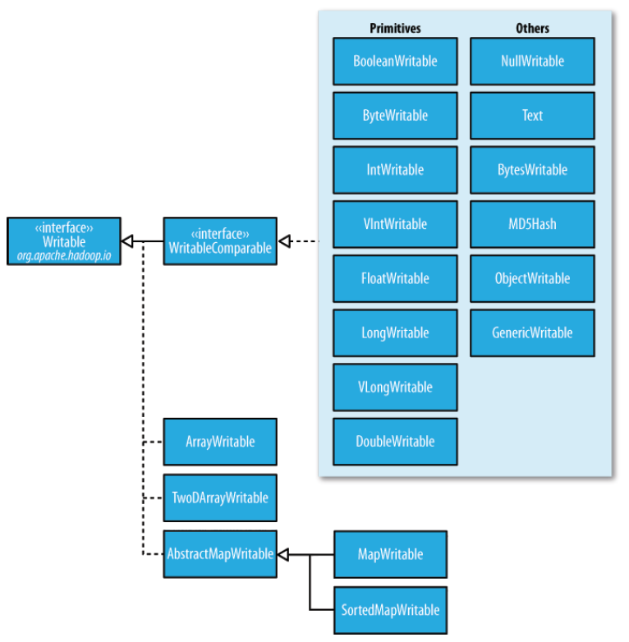

Slide 8
public class MyWritable implements Writable {
// Some data
private int counter;
private long timestamp;
public void write(DataOutput out) throws IOException {
out.writeInt(counter);
out.writeLong(timestamp);
}
public void readFields(DataInput in) throws IOException {
counter = in.readInt();
timestamp = in.readLong();
}
public static MyWritable read(DataInput in) throws IOException {
MyWritable w = new MyWritable();
w.readFields(in);
return w;
}
}

Slide 9
public class MyWritableComparable implements WritableComparable {
// Some data
private int counter;
private long timestamp;
public void write(DataOutput out) throws IOException {
out.writeInt(counter);
out.writeLong(timestamp);
}
public void readFields(DataInput in) throws IOException {
counter = in.readInt();
timestamp = in.readLong();
}
public int compareTo(MyWritableComparable w) {
int thisValue = this.value;
int thatValue = ((IntWritable)o).value;
return (thisValue < thatValue ? -1 : (thisValue==thatValue ? 0 : 1));
}
}
Notes:
http://hadoop.apache.org/common/docs/current/api/org/apache/hadoop/io/WritableComparable.html

Slide 10
Getting Data To The Mapper

Slide 11
public static void main(String[] args) throws Exception {
Configuration conf = new Configuration();
String[] otherArgs = new GenericOptionsParser(conf, args).getRemainingArgs();
if (otherArgs.length != 2) {
System.err.println("Usage: wordcount <in> <out>");
System.exit(2);
}
Job job = new Job(conf, "word count");
job.setJarByClass(WordCount.class);
job.setMapperClass(TokenizerMapper.class);
job.setCombinerClass(IntSumReducer.class);
job.setReducerClass(IntSumReducer.class);
job.setOutputKeyClass(Text.class);
job.setOutputValueClass(IntWritable.class);
FileInputFormat.addInputPath(job, new Path(otherArgs[0]));
FileOutputFormat.setOutputPath(job, new Path(otherArgs[1]));
System.exit(job.waitForCompletion(true) ? 0 : 1);
}

Slide 12
Reading Data
Data sets are specified by InputFormats
Defines input data (e.g., a directory)
Identifies partitions of the data that form an InputSplit
Factory for RecordReader objects to extract (k, v) records from the input source

Slide 13
Input Format
InputFormat describes the input-specification for a Map-Reduce job
The Map-Reduce framework relies on the InputFormat of the job to:
Validate the input-specification of the job.
Split-up the input file(s) into logical InputSplits, each of which is then assigned to an individual Mapper.
Provide the RecordReader implementation to be used to glean input records from the logical InputSplit for processing by the Mapper.
http://hadoop.apache.org/docs/r2.2.0/api/org/apache/hadoop/mapreduce/InputFormat.html

Slide 14
FileInputFormat and Friends
TextInputFormat
Treats each ‘\n’-terminated line of a file as a value
KeyValueTextInputFormat
Maps ‘\n’- terminated text lines of “k SEP v”
SequenceFileInputFormat
Binary file of (k, v) pairs (passing data between the output of one MapReduce job to the input of some other MapReduce job)
SequenceFileAsTextInputFormat
Same, but maps (k.toString(), v.toString())

Slide 15
Filtering File Inputs
FileInputFormat will read all files out of a specified directory and send them to the mapper
Delegates filtering this file list to a method subclasses may override
e.g., Create your own “xyzFileInputFormat” to read *.xyz from directory list

Slide 16
Record Readers
Each InputFormat provides its own RecordReader implementation
Provides (unused?) capability multiplexing
LineRecordReader
Reads a line from a text file
KeyValueRecordReader
Used by KeyValueTextInputFormat

Slide 17
Input Split Size
FileInputFormat will divide large files into chunks
Exact size controlled by mapred.min.split.size
RecordReaders receive file, offset, and length of chunk
Custom InputFormat implementations may override split size
e.g., “NeverChunkFile”

Slide 18
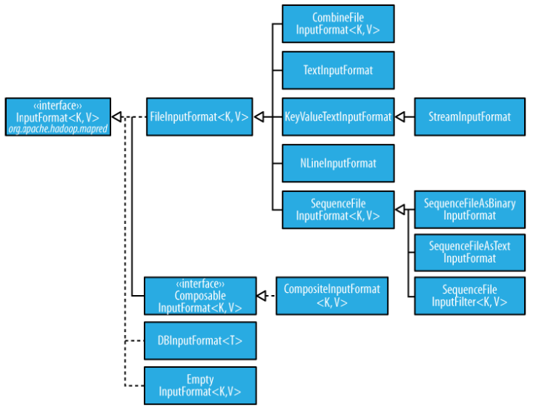

Slide 19
public class ObjectPositionInputFormat extends
FileInputFormat<Text, Point3D> {
public RecordReader<Text, Point3D> getRecordReader(
InputSplit input, JobConf job, Reporter reporter)
throws IOException {
reporter.setStatus(input.toString());
return new ObjPosRecordReader(job, (FileSplit)input);
}
InputSplit[] getSplits(JobConf job, int numSplits) throuw IOException;
}

Slide 20
class ObjPosRecordReader implements RecordReader<Text, Point3D> {
public ObjPosRecordReader(JobConf job, FileSplit split) throws IOException {}
public boolean next(Text key, Point3D value) throws IOException {
// get the next line}
public Text createKey() {
}
public Point3D createValue() {
}
public long getPos() throws IOException {
}
public void close() throws IOException {
}
public float getProgress() throws IOException {}
}

Slide 21
Sending Data To Reducers
Map function produces Map.Context object
Map.context() takes (k, v) elements
Any (WritableComparable, Writable) can be used

Slide 22
WritableComparator
Compares WritableComparable data
Will call WritableComparable.compare()
Can provide fast path for serialized data

Slide 23
Partition And Shuffle

Slide 24
Partitioner
int getPartition(key, val, numPartitions)
Outputs the partition number for a given key
One partition == values sent to one Reduce task
HashPartitioner used by default
Uses key.hashCode() to return partition num
Job sets Partitioner implementation

Slide 25
public class MyPartitioner implements Partitioner<IntWritable,Text> {
@Override
public int getPartition(IntWritable key, Text value, int numPartitions) {
/* Pretty ugly hard coded partitioning function. Don't do that in practice, it is just for the sake of understanding. */
int nbOccurences = key.get();
if( nbOccurences < 3 )
return 0;
else
return 1;
}
@Override
public void configure(JobConf arg0) {
}
}
job.setPartitionerClass(MyPartitioner.class);

Slide 26
Reducer<KEYIN,VALUEIN,KEYOUT,VALUEOUT>
Reduces a set of intermediate values which share a key to a smaller set of values.
Reducer has 3 primary phases:
Shuffle
Sort
Reduce
http://hadoop.apache.org/docs/r2.2.0/api/org/apache/hadoop/mapreduce/Reducer.html

Slide 27
public static class IntSumReducer
extends Reducer<Text,IntWritable,Text,IntWritable> {
private IntWritable result = new IntWritable();
public void reduce(Text key, Iterable<IntWritable> values,
Context context
) throws IOException, InterruptedException {
int sum = 0;
for (IntWritable val : values) {
sum += val.get();
}
result.set(sum);
context.write(key, result);
}
}

Slide 28
Finally: Writing The Output

Slide 29
OutputFormat
Analogous to InputFormat
TextOutputFormat
Writes “key val\n” strings to output file
SequenceFileOutputFormat
Uses a binary format to pack (k, v) pairs
NullOutputFormat
Discards output

Slide 30
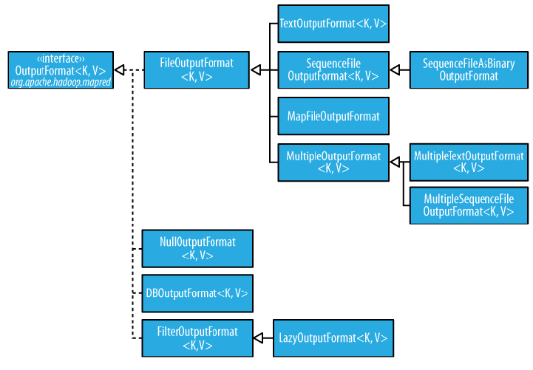

Slide 31
public static void main(String[] args) throws Exception {
Configuration conf = new Configuration();
String[] otherArgs = new GenericOptionsParser(conf, args).getRemainingArgs();
if (otherArgs.length != 2) {
System.err.println("Usage: wordcount <in> <out>");
System.exit(2);
}
Job job = new Job(conf, "word count");
job.setJarByClass(WordCount.class);
job.setMapperClass(TokenizerMapper.class);
job.setCombinerClass(IntSumReducer.class);
job.setReducerClass(IntSumReducer.class);
job.setOutputKeyClass(Text.class);
job.setOutputValueClass(IntWritable.class);
FileInputFormat.addInputPath(job, new Path(otherArgs[0]));
FileOutputFormat.setOutputPath(job, new Path(otherArgs[1]));
System.exit(job.waitForCompletion(true) ? 0 : 1);
}

Slide 32
Job
The job submitter's view of the Job.
It allows the user to configure the job, submit it, control its execution, and query the state. The set methods only work until the job is submitted, afterwards they will throw an IllegalStateException.
Normally the user creates the application, describes various facets of the job via Job and then submits the job and monitor its progress.
http://hadoop.apache.org/docs/r2.2.0/api/org/apache/hadoop/mapreduce/Job.html

Slide 33
